Slide 1
Cross-Layer Service Composition
Christian Henke
19.10.2010 | Karlsruher Institut für Technologie

Slide 2
Functional Composition – Approaches and Benefits
Cross-Layer Composition
Cross-Layer Architecture
Mediation between Network and Service Level
Demonstrator Scenario
Further Cross-Layer Composition Examples

Slide 3
Network Functional Composition
Clean slate network approach
Application
Transport
Network
Data Link
Physical
Examples:
Forward a Packet
Fragment a Packet
Flow Control
Error Correction

Slide 4
Approaches for Network Functional Composition
Netlet-Approach
Netlets are created and evaluated at design time – chosen at runtime
Application Requirements
Netlet Selection
Basic Network Access

Slide 5
Approaches for Network Functional Composition
Silo-Approach
Network services are ordered – distinct interfaces to upper and lower blocks
Application Requirements
a
b
x
1
2
I
II
IV

Slide 6
Approaches for Network Functional Composition
Dynamic Composition
Network Services can be combined with arbitrary services at runtime
Application Requirements
a
b
2
x
1
II
I
IV

Slide 7
Challenges of Todays Internet
Potential Benefits Functional Composition
Best-effort-Internet Transport
Ossification / New Sub Layers
No-Cross-Layer Information Exchange
Duplicated functions on different layers
No business model for network providers (tussles)
Network composed based on application requirements
Architecture to facilitate integration (SOA approach)
functional blocks receive arbitrary data
No layers – only required functional blocks used
Network providers can offer enhanced services on the path

Slide 8
Cross-Layer Composition
Same Approach, Same Problems; but different scope
SOA Services
(Web Services, Telecommunication Services, Business Processes)
Services
Error Correction,
Reliable Transport,
Transcoding
Network

Slide 9
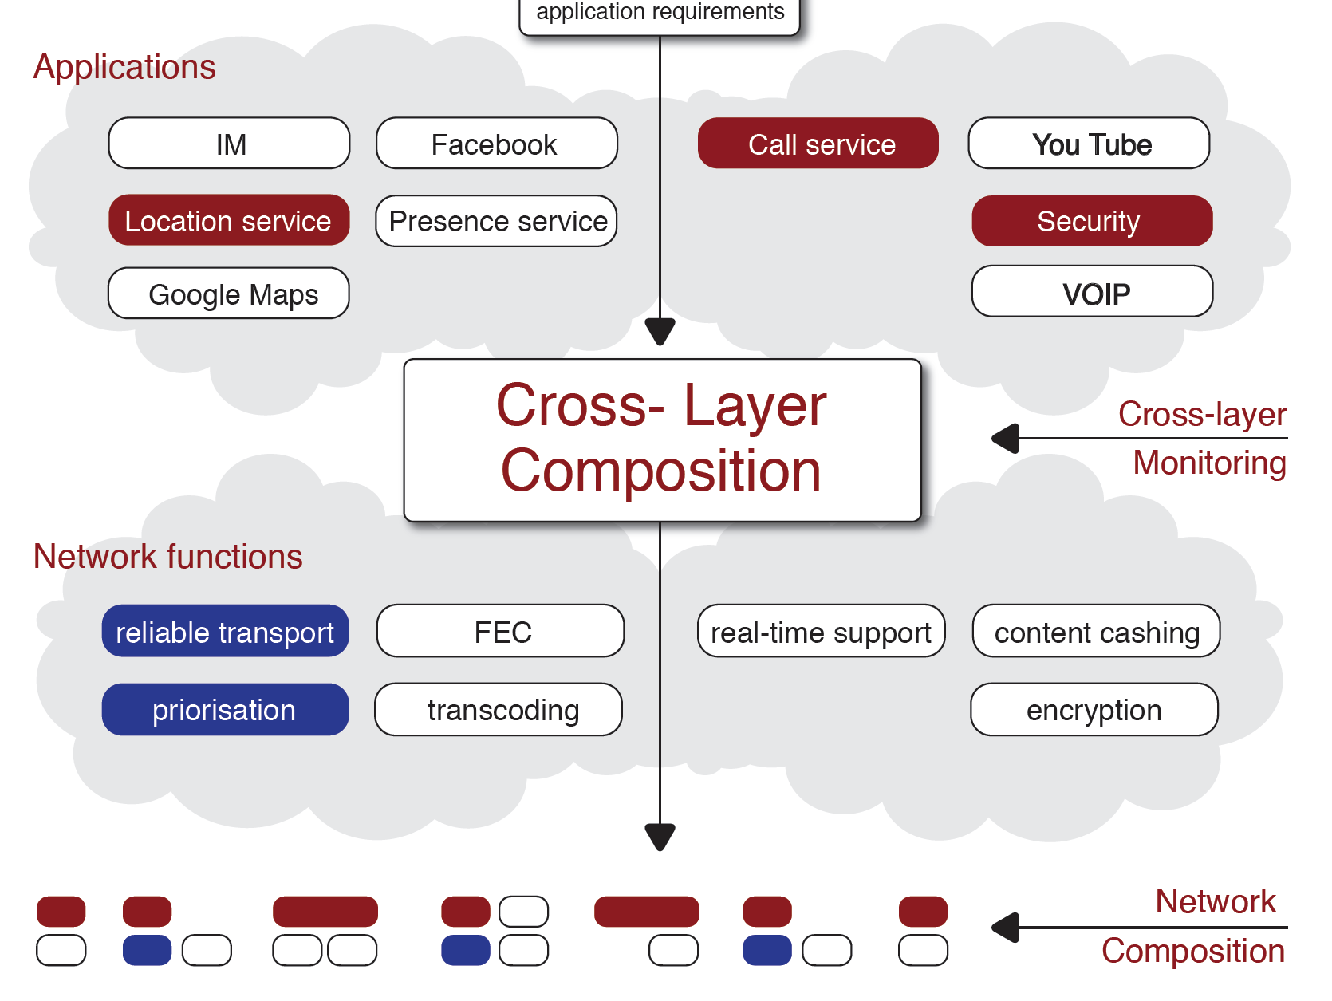
Abstract View on Cross-Layer Composition
Notes:
Shows same as last slide – may skip

Slide 10
Cross-Layer Architecture
Call Service
Authentication
Security Service
Service Broker
Cross-Layer Mediator
Cross-Layer Monitoring
Network Composition
Application
Application
Functional Composition
Functional Composition
Functional Composition

Slide 11
Cross-Layer Composition
Reason for seperating network and service domain:
Lower complexity of network composition process
Network functionality is a limited domain which can be semantically be described
Can incorporate any network architecture
Legacy Internet
that will provide functionality based on requirements
Functional Composition Approaches
Next Generation Mobile Networks (Evolved Packet Core)
Focus: Integrating Network Composition into the Service Composition process

Slide 12
Service Broker
Call Service
Authentication
Service Broker
Security Service
Policy Engine
Service Composition
Workflow Execution
Service Registry
Cross-Layer Monitoring
Network Feedback
(aQoS, Contraints)
Requirements
(QoS, Encryption)
Cross-Layer Mediator
Notes:
Aware of available services
multiple instances of a service
Chooses and composes most appropriate service instances based on
Policies (Network)
User profiles
Cross-Layer Monitoring

Slide 13
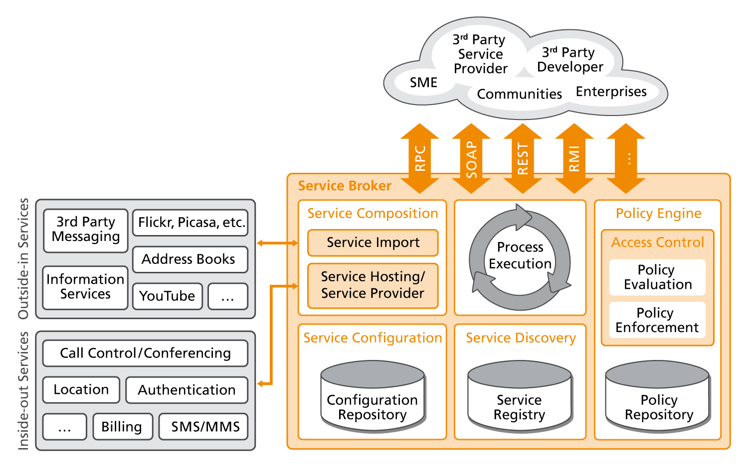
NGN Service Broker Architecture

Slide 14
Service Broker in a requirements driven Network Architecture
Service Broker provides
Exposure of Network Capabilities to 3rd party developers
Secure source of application requirements opposed to user oriented/end system application requirements
express and negotiate application requirements with Network
Trigger service composition based on an Intent – and compose cross-level
Uses policy engine and cross-layer monitoring information to trigger different composition of application level services
Implementation
Uses light-weight SCXML based workflow execution
Based on OSGI equinox
Uses well defined OMA standards – efforts to standardize further interfaces for Future Internet

Slide 15
Guidelines for an unified, flexible and secure service environment Relevance of the OMA standards
The Open Mobile Alliance defines a couple of enablers and principle architectures that support the life-cycle management for external 3rd party service and the internal service provisioning.
Initiatives for service exposure are also covered by the OMA by considering open and well established interface standards from the Parlay group or GSMA.
An open but controlled access on services and network resource is a requirement that is covered by policy based functions.
The existing standards of the OMA reflecting basic mechanisms that are important when integrating external services.
OMA Service Environment
OMA – Next Generation Service Interfaces
OMA – Parlay Service Access
OMA – Policy Evaluation Enforcement Management
OMA – Open Service Provider Environment

Slide 16
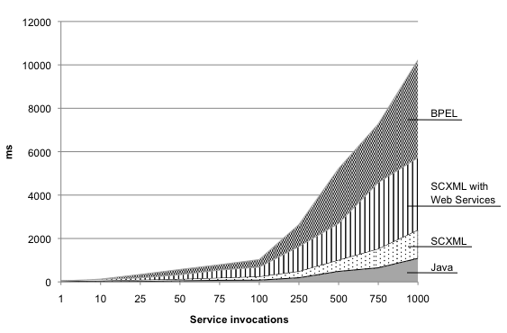
Performance analysis Real-time Service execution of BPEL vs. SCXML vs. Java
Tested with Apache Common SCXML engine and Apache ODE BPEL engine.
Result:
SCXML engine performs better than BPEL
SCXML engine overhead compared to direct execution of Java is negligible
SCXML provides:
Lightwight workflow execution language
Based on state machine model – errors are easy to detect
Can be easily integrated into Java environment

Slide 17
Mediator
Mediator between Network Composition and Service Broker
Abstraction Layer Between Service Broker and any underlying Network Composition
Information Exchange between Network and Service Level
Translation of Network Capabilities and Requirements
Requirements transport to the network
Feedback of the network to application
Helps to decide where service is executed (e.g. encryption, transcoding, virus scan)
Service Broker
Cross-Layer Mediator
Network Composition

Slide 18
Mediator Challenges
Functionality that may reside on both levels
Need to be comparable (same semantic or translation)
How to determine costs? Prefer service over network?
Data cache in the network our outside cloud provider?
Functionalities that may be dependent and need interaction
E.g. prioritization on network should only be available for authenticated and accountable users
Negotiation caching
Only commence negotiation if necessary - caching
Determine a common subset of services that are independent from dynamic constraints

Slide 19
Demonstrator in G-Lab DEEP
VoIP Scenarios
Normal Call – no congestion
Emergency Call – no congestion
Congestion – Normal Call
Congestion – Emergency Call
Authentication
Service Broker
Call Service
Location
Cross-Layer Mediator
Congestion
Cross-Layer Monitoring
Network Composition
Prioritization
Loss-Detection
Basic Network Transport
FEC

Slide 20
Further Examples for Cross-Layer Service Composition
Simple Service Broker – Router Composition
Service Broker OSGI SCXML Engine
Simple Example showing recomposition based on network monitoring services
Lightweight events
Publish subscribe model
Cisco AXP Router
OSGI and SCXML engine
Monitoring Information as Service

Slide 21
Evolved Packet Core (EPC)
EPC is part of the 3GPP Evolved Packet System (EPS)
The EPC is a multi-access core network based on the Internet Protocol (IP) one common packet core network for both
trusted networks including
3GPP Access (LTE-E-UTRAN, UMTS-UTRAN, GPRS-GERAN)
Non 3GPP Access (WIMAX, CDMA2000/HRPD)
and untrusted networks including
Non-3GPP Access (WLAN)
EPC provides connection to IP service domains
IMS
Internet (or others, e.g. P2P etc.)
Important EPC functions include:
NAS and security (AAA)
mobility and connectivity management
policy QoS control and charging (PCC)
IMS
Internet
Evolved
Packet Core
3GPP
Access
e.g. LTE
Non 3GPP
Access
trusted
trusted / untrusted
Notes:
Topic: EPC Architecture and Capabilities Overview
Only explain the bubbles

Slide 22
EPC Support for Applications
Notes:
Independent:
Through Deep Packet Inspection
E.g. We tested it with video services such as youtube
EPC Aware:
Operator services such as IMS, RCS, VoLTE etc.
QoS is reserved based on the requirements of the applications
Events on the access network may be transmitted to the applications
New breed of applications especially tailored for the wireless environment which may use the complete core network enablers for a better service delivery, like the location info available in the ANDSF, the ambient information from the PCC and access network management, and identity through HSS

Slide 23
Interconnection with Applications
OpenEPC enables applications and service platforms to transmit requirements for the policy based decision for resource reservation
services receive their required QoS
OpenEPC notifies applications on events happening on the access and core network level
services can dynamically adapt to the momentary access network conditions
For demonstration purposes, OpenEPC Rel. 1 includes a set of additional application level components, the demonstration enablers, extended to support the integration with the OpenEPC
Notes:
Together with OpenEPC Rel. 1 a set of additional components are provided. Although these are not essential for the functionality of the OpenEPC, they provide the role of enhancing and showcasing the advantages of the OpenEPC enabling a fast development of similar components. The additional OpenEPC enablers include the following:
1. Video Streaming application with adaptive bit-rates - It enables the fast show-casing of video applications over the IP wireless environment and their adaptation to the current context of the mobile device. This application enables an initial understanding and demonstration on the requirements and possible solutions for the next generation of applications especially created for the broadband wireless environment.
2. HTTP Interceptor - Besides serving applications which are designed to inter-work with the OpenEPC, the testbed is capable to accustom also for Over-The-Top (OTT) applications. For demonstrating such a scenario, in which the data traffic is analyzed, a simple Deep-Packet-Inspection (DPI) tool was developed reusing the Squid HTTP Proxy by hooking to a built-in feature.
3. Open IMS Core - For providing demonstration using telephony services in the context of broadband IP wireless technologies, Open Source IMS Core Project has been extended and fully supports the integration and the inter-operability between the IMS and the EPC layers.

Slide 24
Conclusion
Functional Composition as Approach for Future Internet
Cross-Layer Composition of network and application level services
Composition based on user and application requirements
Architecture draft with Mediator between Application and Network
Scenarios that demonstrate the flexibility of the Approach
Current Work - Research Areas:
Service Description, Composition and Selection - Rahamatullah Khondoker
Application Requirement Description
Mediation
Message exchange
Scenarios
standardisation
Cross-Layer Monitoring to enhance QoS aware composition + security

Slide 25
Questions?
c.henke@tu-berlin.de
www.av.tu-berlin.de

Slide 26
References
Functional Composition Approaches
Christian Henke, Abbas Ali Siddiqui, Rahamatullah Khondoker. Network Functional Composition: State of Art. To be presented at ATNAC 2010. New Zealand October 2010.
G-Lab DEEP
Abbas Ali Siddiqui, Christian Henke, Daniel Günther, Paul Müller, Thomas Magedanz. Mediation between Service and Network Composition. Euroview 2010, Würzburg Germany. August 2010. Online
Christian Henke, et.al. Scenarios for a Future Internet based on Cross-Layer Functional Composition. 5th GI/ITG KuVS Workshop on Future Internet. Stuttgart, Germany. June 2010.
G-Lab Deep: Cross-layer Composition and Security for a flexible Future Internet. International ICST Conference on Testbeds and Research Infrastructures for the Development of Networks & Communities (Tridentcom) 2010.
"Addressing Security in a Cross-Layer Composition Architecture", 10th Würzburg Workshop on IP: Joint ITG, ITC, and Euro-NF Workshop "Visions of Future Generation Networks“ EuroView Würzburg, Germany, August 2, 2010
“A Demonstrator for Cross-Layer Composition” 10th Würzburg Workshop on IP: Joint ITG, ITC, and Euro-NF Workshop "Visions of Future Generation Networks“ EuroView Würzburg, Germany, August 2, 2010

Slide 27
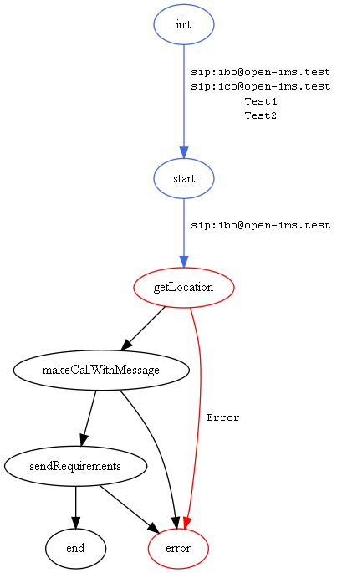
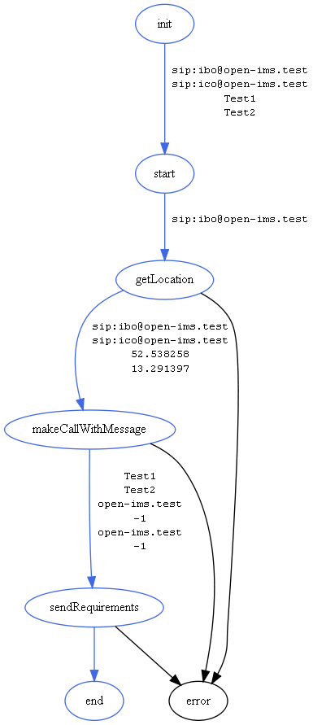
Workflow Visualisation

