Slide 1
Service Composition and Selection in Service Oriented Network Architecture (SONATE)
26th October 2010
M. Rahamatullah Khondoker

Slide 2
Outline
Motivation for SONATE
Overview of SONATE Concepts and Terminologies
Building Blocks
Workflows
Framework
Service Composition
Service Selection
Conclusions and Outlook
Discussion

Slide 3
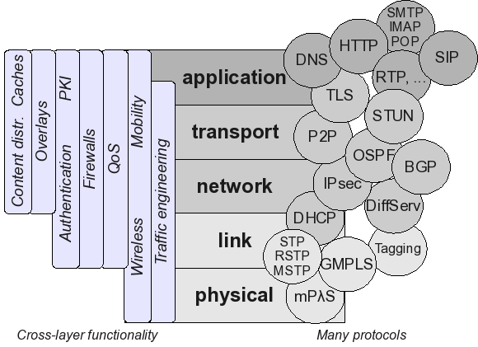
Problem Statement
It is hard to integrate new mechanisms into the current Internet
Because:
Many implicit dependencies (i.e. tight coupling) between existing mechanisms
The problem is not limited to specific protocols or mechanisms
It is an architectural issue!

Slide 4
Motivation for SONATE
A Future Network architecture should be flexible:
Long term flexibility:
Support evolution of networks
Short term flexibility
Dynamically adapt to requirements and constraints

Slide 5
Long Term Flexibility
Enable: stepwise introduction of new functionality
Easy introduction of new functionality without depending on agreements with vendors / providers
Reasons:
Enable utilization of highly specific or experimental functionality
Reduce time to market
Opportunity for small companies to provide (network-) services
Of course standardization is still required
Solution: Loose Coupling

Slide 6
Short Term Flexibility
Requirements of current application, e.g.
Different behaviour for regular and emergency phone calls
Current network constraints, e.g.
Mobile or wired network access
A Network may require authentication when prioritization is requested
Capabilities of currently involved nodes
Adapt to supported functionality. This is important to utilize new functionality.
Solution: Dynamic Adaptation

Slide 7
SONATE Concepts

Slide 8
Building Blocks
Functionality is provided by self-contained building blocks (BB)
Micro-protocols (e.g. flow-control, retransmission or a video codec)
Other functionality (e.g. monitoring or lookup services)
BB have generic and well-defined interfaces
Effects,
Ports,
etc.
Effects,
Ports,
etc.
Effects,
Ports,
etc.
Effects,
Ports,
etc.
Description (XML)
BB Code

Slide 9
Services
A Service
Can be seen as a set of visible effects of the underlying implementation of a protocol or mechanism
Hides implementation mechanisms
Examples of effects
Reliable transmission, Addressing, Security, Routing, Loss Detection, Loss Reduction, Loop Avoidance, Connection Management, etc.

Slide 10
Workflow
Interaction of Services is defined by a workflow description
Order of Services
Possible data exchange
Descriptions can be changed easier than code
Placement of a functionality is not fixed

Slide 11
Workflow
Interaction of Services is defined by a workflow description
Order of Services
Possible data exchange
Descriptions can be changed easier than code
Placement of a functionality is not fixed
Loose coupling achieved by:
Building blocks & Workflow-Descriptions
Foster long term flexibility

Slide 12
SONATE Framework
Workflow processing
Management of services
From Application
To Application
Msg1
Msg2
Msg3
Workflow
Engine
Msg1’
Msg2’
Msg3’
receive
send
From previous node
To successor node
Timer, Events, debugging support, …
Shared Data Structures
Physical or virtual link
Physical or virtual link
Repository of building blocks

Slide 13
Service Composition
Create workflow descriptions
Select services to be used
Compose (connect) services
Adapt to (current) requirements and constraints
Application: Requirements
Network: Constraints
…
Service
Composition

Slide 14
Signal Workflows
Be independent of Service Composition algorithms
Intermediate nodes may
alter workflows, i.e. act as gateways
provide feedback, i.e. request different behavior
Functional
Composition
Functional
Composition
Framework
Framework
Framework
Msgs
Msgs
Msgs
Msgs
Initiator
Next Node
Gateway Node
Notes:
Gateways, firewalls could be implemented by modifying the workflow

Slide 15
Signal Workflows
Be independent of Service Composition algorithms
Intermediate nodes may
alter workflows, i.e. act as gateways
provide feedback, i.e. request different behavior
Dynamic adaption achieved by:
Service Composition & Processing of Workflow-Descriptions
Foster short term flexibility
Functional
Composition
Functional
Composition
Framework
Framework
Framework
Msgs
Msgs
Msgs
Msgs
Initiator
Next Node
Gateway Node

Slide 16
Service Selection

Slide 17
Service Selection
Service Composition Approaches
Manually (supported by tools)
Templates (predefined structure, delayed completion)
Genetic algorithms (automatic but time consuming process)
Compose few coarse grain modules / partial workflows
Compose fine grained building blocks

Slide 18
Service Selection
Composition approaches differ according to
Tradeoff: When to perform vs. Information availability
Design time: General requirements and protocols are known
Deployment time: General application requirements and system constraints are known
Run time: User requirements and available resources are known
Flexibility
Effort for calculation
It is unlikely that one approach is always optimal

Slide 19
Service Selection Process
Application
Requirements
Network Abstraction API
Access to Service Provider
Selected Service
Service Broker
Requirements
Offerings
Conventional
TCP/IP
UDP/IP
SCTP/IP
…
Compound
Template
S&C
…
Service Providers
Notes:
Many services, some sources can take time
Running top of the framework

Slide 20
Requirements: Service Selection
Service Description
For comparing application requirements and offered services
Service Selection Methodology
For getting suitable services
For getting the best service

Slide 21
Service Selection: Service Description
Used to determine for a requested service
Which offered services are suitable
(i.e. fulfills all compulsory requirements)
Which suitable service is optimal
(i.e. compare properties of service)
Describe services using two types of properties
Mandatory properties, attributes using absolute values
<PropID, lower-bound, upper-bound>
Examples: compare MTU size, average Bandwidth, Costs, …
Optional properties, attributes using absolute values
<PropID, rating> rating [-9,9]
Examples: decide to increase security vs. reduce delay

Slide 22
Service Selection: Methodology
Service Selection Methodology
For getting an optimal service, optimization of optional properties is required
For example, security and delay of similar services
We need Multiple Criteria Decision Analysis (MCDA)
Several algorithms (MAUT, AHP, ELECTRE III, Evamix) exist for doing this
Where as no other MCDA methods allow interdependence of different criteria, AHP does that
We used Analytic Hierarchy Process (AHP)
Checking consistency of evaluation measures
Reduces biased behavior in decision making process
AHP must be adapted for automatic service selection

Slide 23
Service Selection: AHP
Absolutely Less
Moderately Less
Equal
Moderately More
Absolutely More
-9
-7
-5
-3
-1 or 1
3
5
7
9
Fig. Pairwise comparison scale
Fig. Analytic Hierarchy Process (AHP)
Notes:
Reason of pairwise priority? Easy

Slide 24
Service Selection: Usage of AHP
AHP in service description and selection
Input
A set of effects
Requirements
Pairwise priority assignment
Calculate one priority for each effect
Offers
Pairwise priority assignment
This requires a mapping mechanism which cannot be done by AHP
Calculate one priority for each effect
Output
A service with the highest priority value
Notes:
Cannot be done by human? Needs to be done automatically.

Slide 25
Service Selection
The priority assigned in requirements needs to be mapped to the offered services
Pairwise prioritization of services per effect
The mapping must be generic
The mapping should be monotonic
A linear mapping of measured values to prioritization is not adequate
An approach for mapping is proposed to use monotonic interpolation/extrapolation
9
Hints
Measured value
Priority
+/- 1
-9
Measured value of offers
Fig. Values in terms of hints

Slide 26
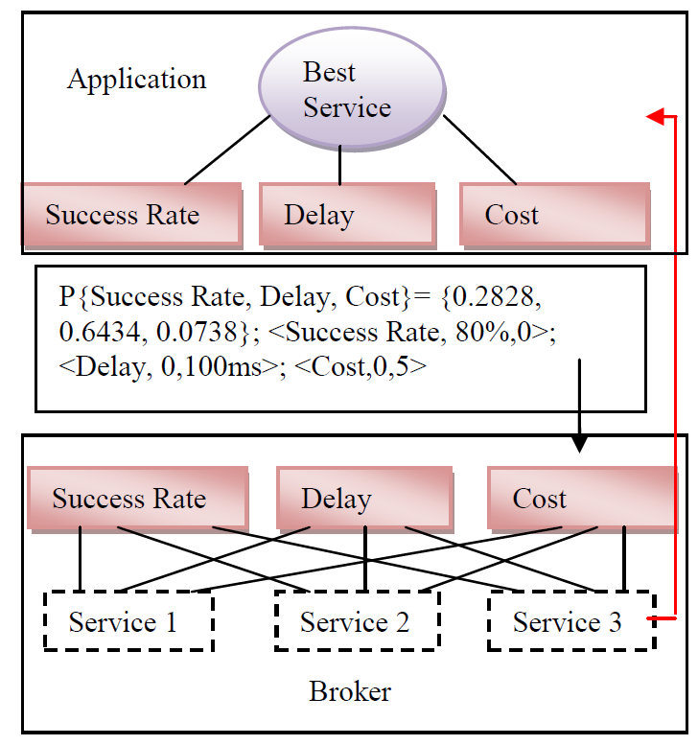
Example: AHP in Service Selection
Application Requirements
Offerings

Slide 27
Summary and Outlook
Summary
SONATE as a flexible network architecture
Service Description
Service Selection
Analytic Hierarchy Process (AHP)
Outlook
Service Composition Challenges

Slide 28
Thanks for your attention
Any questions, comments or concerns?

Slide 29
Discussion Questions?
Assuming that more than one services provide the same functionality. In that case, we need mechanisms for rating those services to select the most appropriate one.
How to do rating of composed services?
Which time is suitable for rating a composed service Design time, deployment time or runtime?
Do we have enough information to aggregate properties at that time? For example, delay and security of a service

Slide 30
Discussion Questions?
Assuming that a service, Reliable transmission, can be offered as a coarse-grained service or it can also be offered by following services
Error detection
Order preservation
Error control
Data flow limiting
Which grained of service is better? Coarse-grained or fine-grained. Why?

Slide 31
Discussion Questions?
Services might be dependent on each other. These dependency information can be written statically or can be obtained dynamically by analysing their semantics.
Which way of obtaining dependency is better? Why? What properties to be in the service description so that dependency information can be obtained automatically?

Slide 32
Discussion Questions?
Where to place services? End-to-end, every node, or in the middle boxes?

Slide 33
Discussion Questions?
How to deal with heterogeneous services?

Slide 34
M. Rahamatullah Khondoker, M.Sc.
Phone: +49 (0)631 205-26 43
Fax: +49 (0)631 205-30 56
Email: khondoker@informatik.uni-kl.de
Internet: http://www.icsy.de

Slide 35
Analytic Hierarchy Process (AHP): step 1
Ref: This example is taken from the slides of Dr. S. Tom Foster, Jr. and Dr. Gerald LaCava

Slide 36
Analytic Hierarchy Process (AHP): step 2
Ref: This example is taken from the slides of Dr. S. Tom Foster, Jr. and Dr. Gerald LaCava

Slide 37
Analytic Hierarchy Process (AHP): step 3
Ref: This example is taken from the slides of Dr. S. Tom Foster, Jr. and Dr. Gerald LaCava

Slide 38
Analytic Hierarchy Process (AHP): step 4
Ref: This example is taken from the slides of Dr. S. Tom Foster, Jr. and Dr. Gerald LaCava

Slide 39
Analytic Hierarchy Process (AHP): step 5
Ref: This example is taken from the slides of Dr. S. Tom Foster, Jr. and Dr. Gerald LaCava

Slide 40
Analytic Hierarchy Process (AHP): step 6
Ref: This example is taken from the slides of Dr. S. Tom Foster, Jr. and Dr. Gerald LaCava

Slide 41
Analytic Hierarchy Process (AHP): step 7
Ref: This example is taken from the slides of Dr. S. Tom Foster, Jr. and Dr. Gerald LaCava

Slide 42
Analytic Hierarchy Process (AHP): step 8
Ref: This example is taken from the slides of Dr. S. Tom Foster, Jr. and Dr. Gerald LaCava

Slide 43
Analytic Hierarchy Process (AHP): step 9
Ref: This example is taken from the slides of Dr. S. Tom Foster, Jr. and Dr. Gerald LaCava

Slide 44
Analytic Hierarchy Process (AHP): step 10
Ref: This example is taken from the slides of Dr. S. Tom Foster, Jr. and Dr. Gerald LaCava

